Slide 1
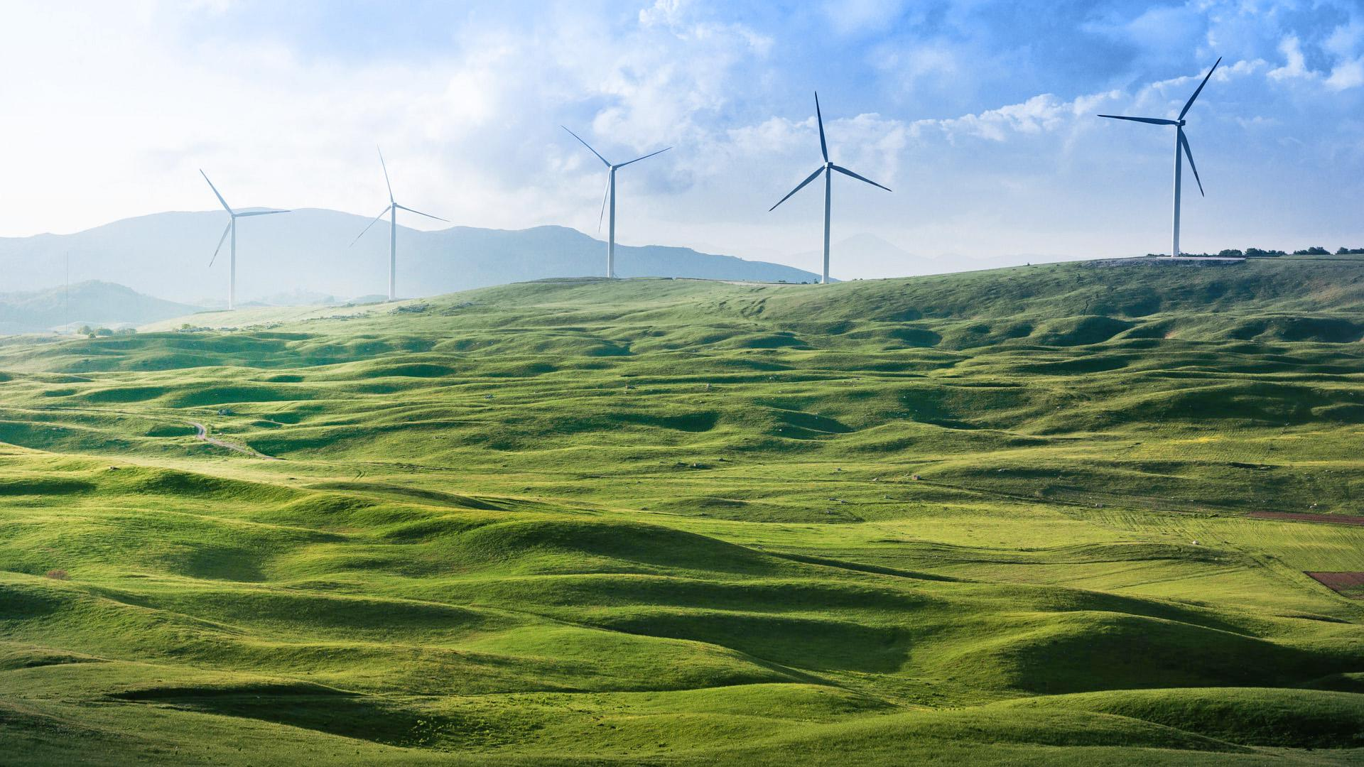
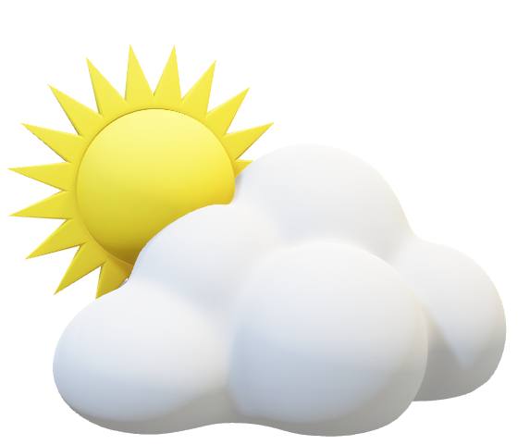
Weather Forecast App

Slide 2
Sunshine is delicious, rain is refreshing, wind braces us up, snow is exhilarating; there is really no such thing as bad weather, only different kinds of good weather.

Slide 3

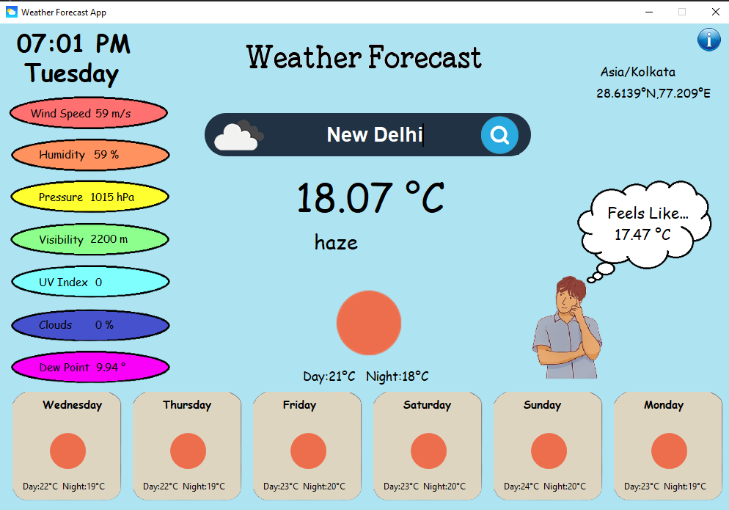
Desktop Application
Place your screenshot here

Slide 4
Overview
Weather forecasting is mainly concerned with the prediction of weather condition in the given future time. Weather forecasts provide critical information about future weather. There are various approaches available in weather forecasting, from relatively simple observation of the sky to highly complex computerized mathematical models. The prediction of weather condition is essential for various applications. Some of them are climate monitoring, drought detection, severe weather prediction, agriculture and production, planning in energy industry, aviation industry, communication, pollution dispersal, and so forth. Accurate prediction of weather conditions is a difficult task due to the dynamic nature of atmosphere.

Slide 5
Weather Details
Temperature
Wind Speed
Humidity
Pressure
Visibility
UV Index
Clouds
Dew Point

Slide 6
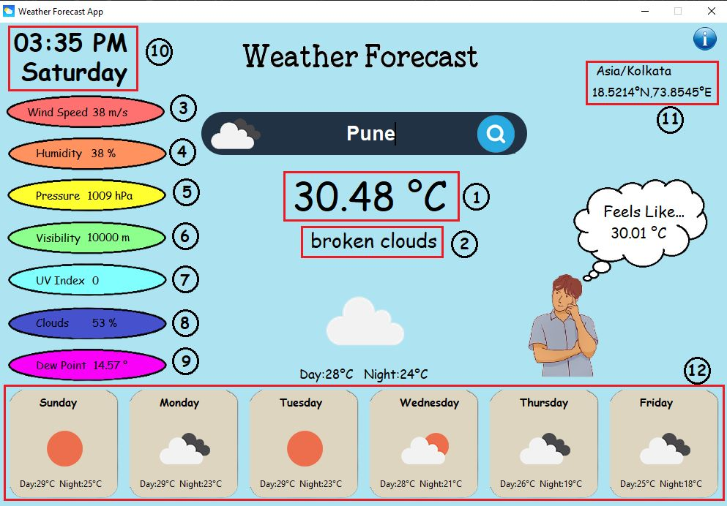

Slide 7
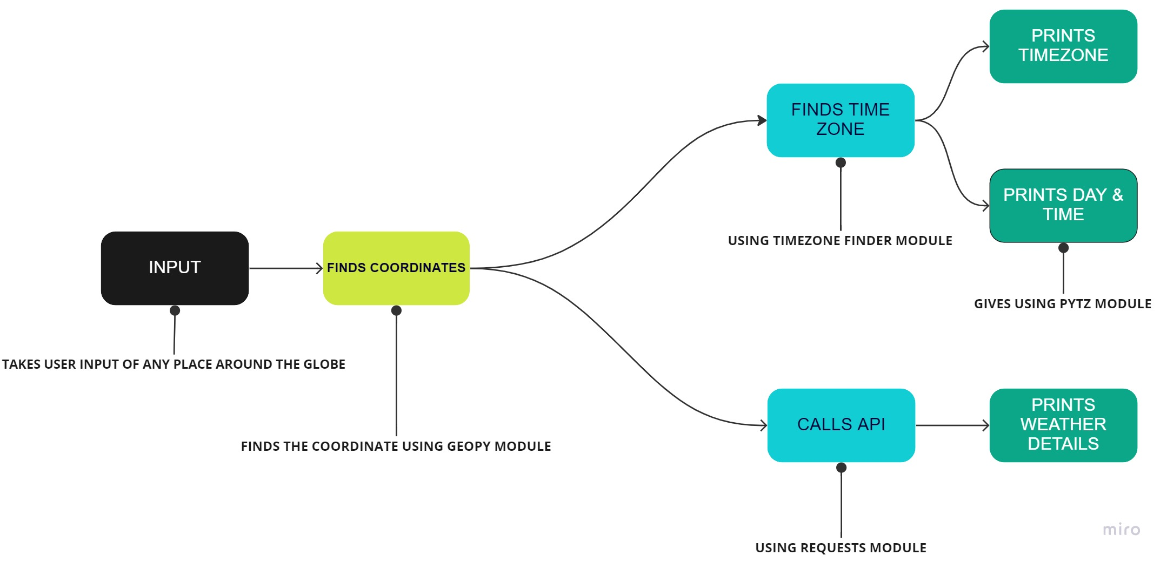
DETAILED WORKING PROCEDURE OF CODE

Slide 8
Time Zone Map of world

Slide 9
System Requirements
Hardware /Software | Hardware /Software Elements | Specification/Version
Hardware | Processor | Intel i3/i5/i7 or AMD
 | RAM | Min 4GB
 | HDD/SSD | Min 250 GB
Software | OS | Windows/ Linux/ Mac OS
Connectivity | Wi-Fi | Atleast 1 MBPS

Slide 10








Diagrams and infographics
few clouds
clear sky
mist
snow
thunderstorm
shower rain
scattered clouds
rain

Slide 11
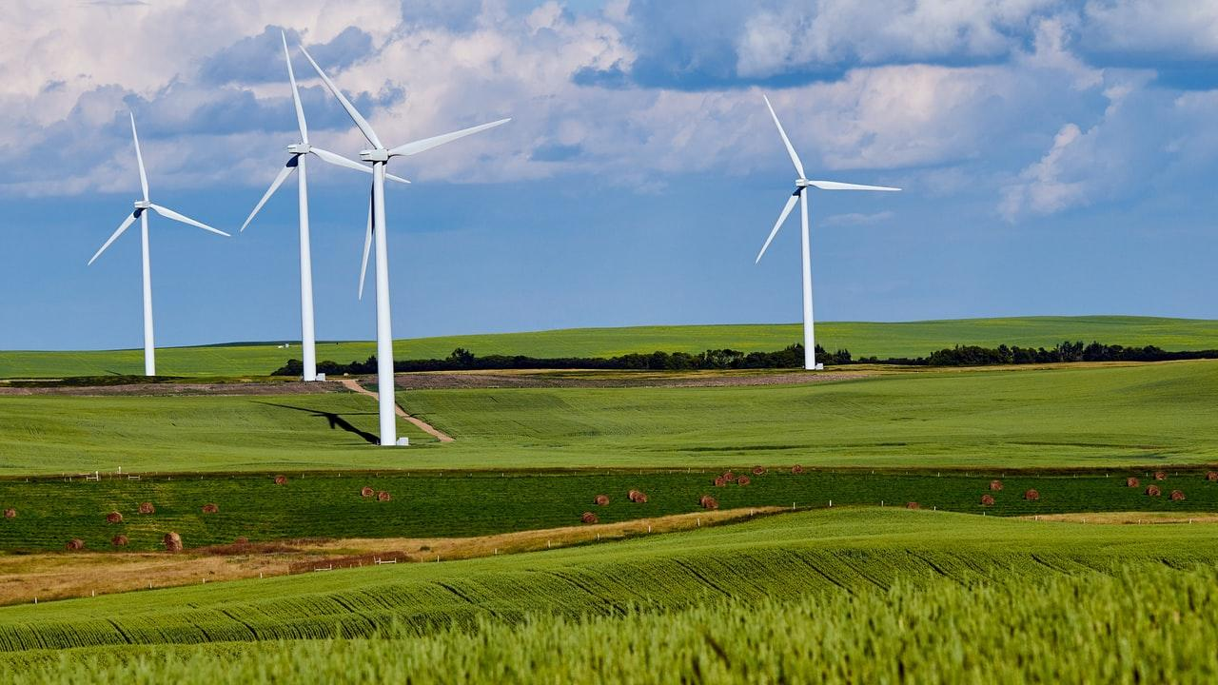
Conclusion
From this presentation, greater local weather condition data is provided to meteorological departments across the world to make predictions in different regions more accurate and quicker. This data is then linked to all the sensors globally which creates more data for everyone as a whole. By installing a weather monitoring system at home, you are supporting the growth and development of this field, because of contributing to worthy data that can further help these departments. It can have a significant meaning for future developments in weather prediction technology, making our lives more efficient.

Slide 12




Team Presentation
Atharva Narkhede AP21110011028
Ankush Kumar AP21110011026
Rahul Bajaj
AP21110011022
Prafull Raj
AP21110011016

Slide 13
Thank You!

